Slide 1
LOCAL SERVICE PROVIDER
GROUP MEMBERS:-
NAME ROLL NO.
SHAILESH HAWALE 14
SHRAVANI RODGE 32
SHRESHA SINHA 36

Slide 2
INDEX
SR. NO. | CONTENT
1. | INTRODUCTION
2. | LITERATURE SURVEY
3. | PROBLEM STATEMENT(EXISTING SYSTEM)
4. | PROBLEM STATEMENT(PROPOSED SYSTEM)
5. | DATA FLOW
6. | SYSTEM DESIGN
7. | RESULTS
8. | CONCLUSION
9. | REFERENCES

Slide 3
INTRODUCTION
Local Service Provider is the one-stop destination for reliable, professional, and convenient services tailored to meet your needs.
We take pleasure in serving the local community with a wide range of high-quality services designed to make your life easier.
Whether you’re looking for home repairs, maintenance, or specialized assistance, our team of experienced is here to deliver prompt, efficient solutions.

Slide 4
LITERATURE SURVEY
Sr.No | Research Paper | Author | Techniques Used | Advantages | Disadvantages
1 | "A Comprehensive Online Business Directory Platform Using MERN Stack" | Ravi Kumar, Suresh Babu | MongoDB, Express.js, React.js, Node.js, Google Maps API, Payment Gateway Integration | Advantages: Scalable, efficient, easy to maintain, cross-platform compatibility. | Disadvantages: Requires strong JavaScript skills, potential performance issues with large datasets.
2 | "Developing a Local Business Directory App with MERN Stack" | Priya Patel, Ashish Mehta | MongoDB, Express.js, React.js, Node.js, Geolocation API, User Reviews | Real-time updates, personalized recommendations, user-friendly interface | Requires continuous maintenance, data security concerns.
3 | "MERN Stack-Based Business Directory: A Case Study" | Rahul Sharma, Anjali Singh | MongoDB, Express.js, React.js, Node.js, Search Engine Optimization (SEO), Social Media Integration | Improved visibility, enhanced user engagement, ability to generate revenue through advertising. | Requires marketing efforts, potential for competition from established platforms.

Slide 5
LITERATURE SURVEY
Sr.No | Research Paper | Author | Techniques Used | Advantages | Disadvantages
4 | "Building a Scalable Business Directory Platform with MERN Stack" | Avinash Gupta, Neha Verma | MongoDB, Express.js, React.js, Node.js, Cloud-based infrastructure, Load balancing | High performance, fault tolerance, global reach. | Increased costs, complex management.
5 | "A Comparative Study of MERN Stack vs. Other Frameworks for Business Directory Development" | Nikhil Jain, Meghana Rao | MongoDB, Express.js, React.js, Node.js, Django, Laravel, Ruby on Rails | Full-stack JavaScript ecosystem, rapid development, flexibility. | Learning curve for beginners, potential performance limitations compared to compiled languages.

Slide 6
PROBLEM STATEMENT (EXISTING SYSYEM)
Outdated Design: The website lacks a modern, user-friendly interface, making it visually unappealing and difficult to navigate.
No Mobile Responsiveness: The website does not adapt to mobile devices, limiting accessibility for users on smartphones and tablets.
Lack of Online Booking: The site does not offer online appointment booking, causing inconvenience for users who prefer digital scheduling.
Inefficient Content Management: Updating or adding new services, promotions, or announcements is cumbersome and slow.

Slide 7
PROBLEM STATEMENT (PROPOSED SYSYEM)
Business directory website : Create a web-based platform where businesses can list their services, and users can search for and discover these businesses. This can be tailored to specific niches such as local services, professionals, or industry-specific directories.
Business Listings: Business owners can create, edit, and delete listings Include details such as business name, contact information, services offered, and operating hours.
Search and Filters: Search bar for users to find businesses by name, category, or location. Filters for narrowing down search result
Categories and Tags: Businesses can be categorized by type and tagged with relevant keywords. Users can browse businesses by category

Slide 8
DATA FLOW
LOGIN/SIGN UP
PAYMENT MANAGEMENT
LOCAL SERVICE PROVIDER
SYSTEM USER MANAGEMENT
BUSINESS MANAGEMENT
SERVICE MANAGEMENT
CUSTOMER MANAGEMENT

Slide 9
SYSTEM DESIGN
SOFTWARE SPECIFICATION:-
Visual Studio
Language
Frontend:-HTML, CSS
Backend:-Node JS(Express JS)
Database:-MongoDB
HARDWARE SPECIFICATION:-
Processor – AMD Ryzen 5
Windows 11
Hard Disk- 500 GB
Memory- 8GB RAM

Slide 10
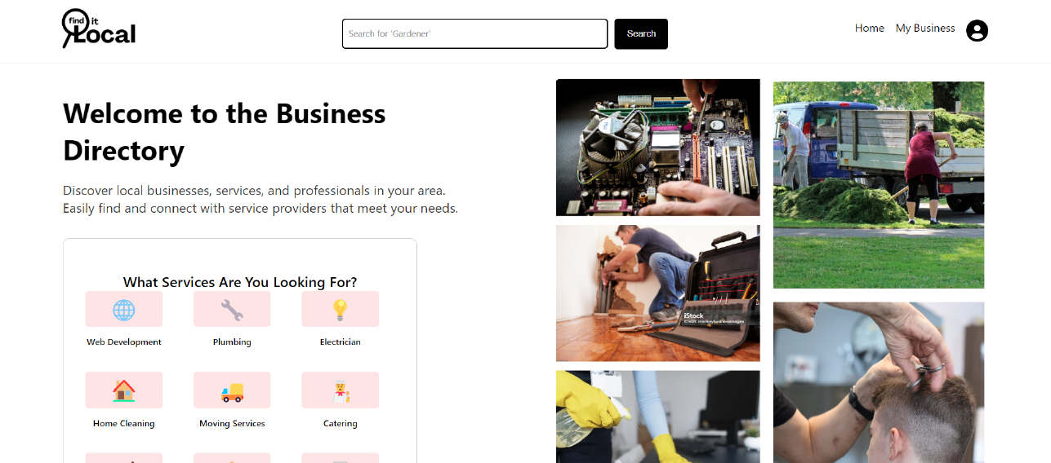
Result

Slide 11
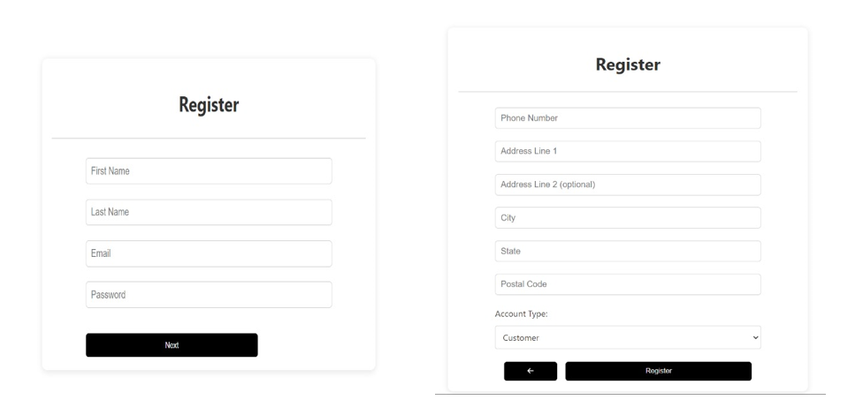
REGISTER PAGE

Slide 12
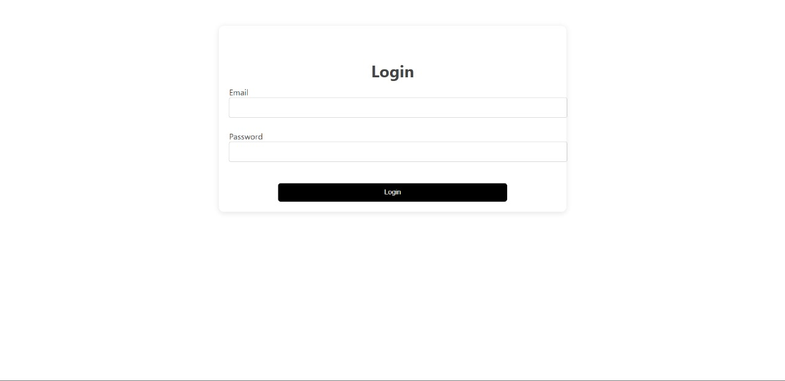
LOGIN PAGE

Slide 13
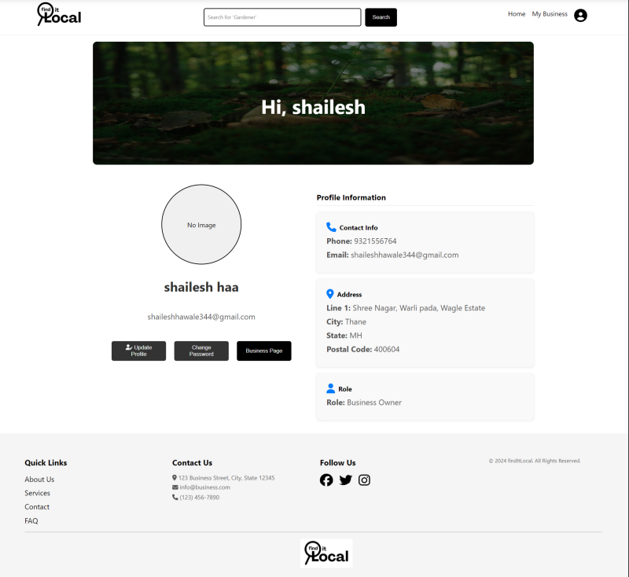
USER PROFILE PAGE

Slide 14
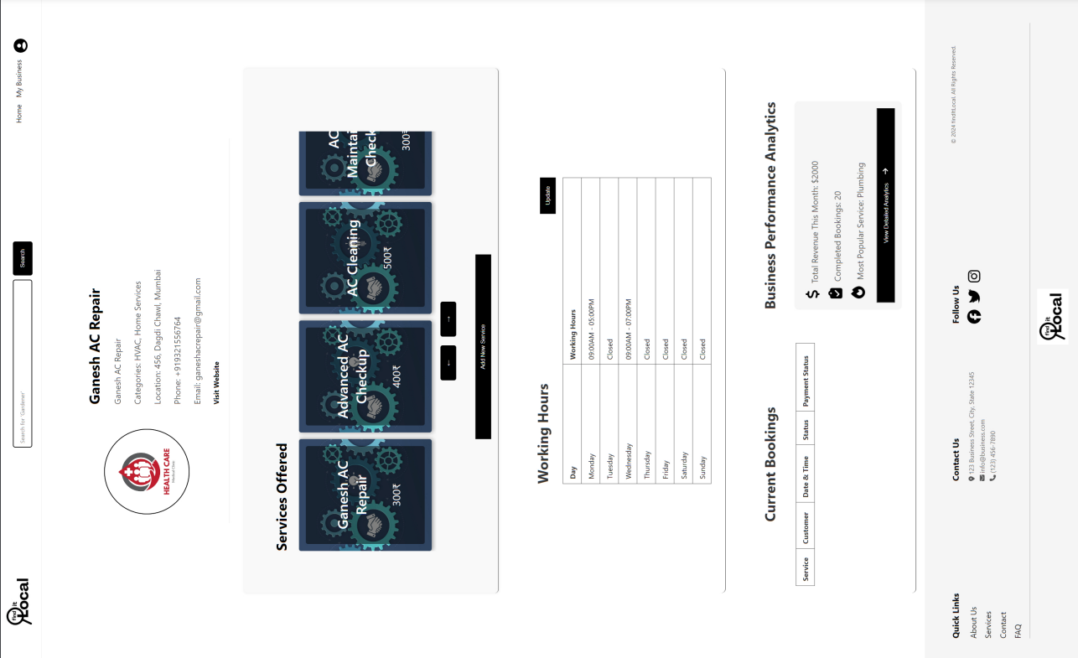
BUSINESS DASHBOARD

Slide 15
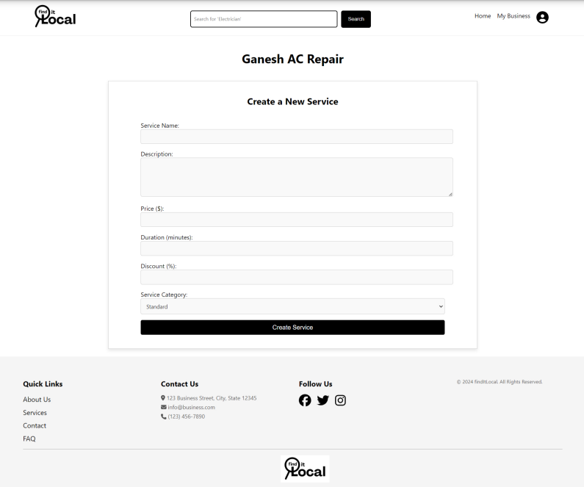
CREATE NEW SERVICE PAGE

Slide 16
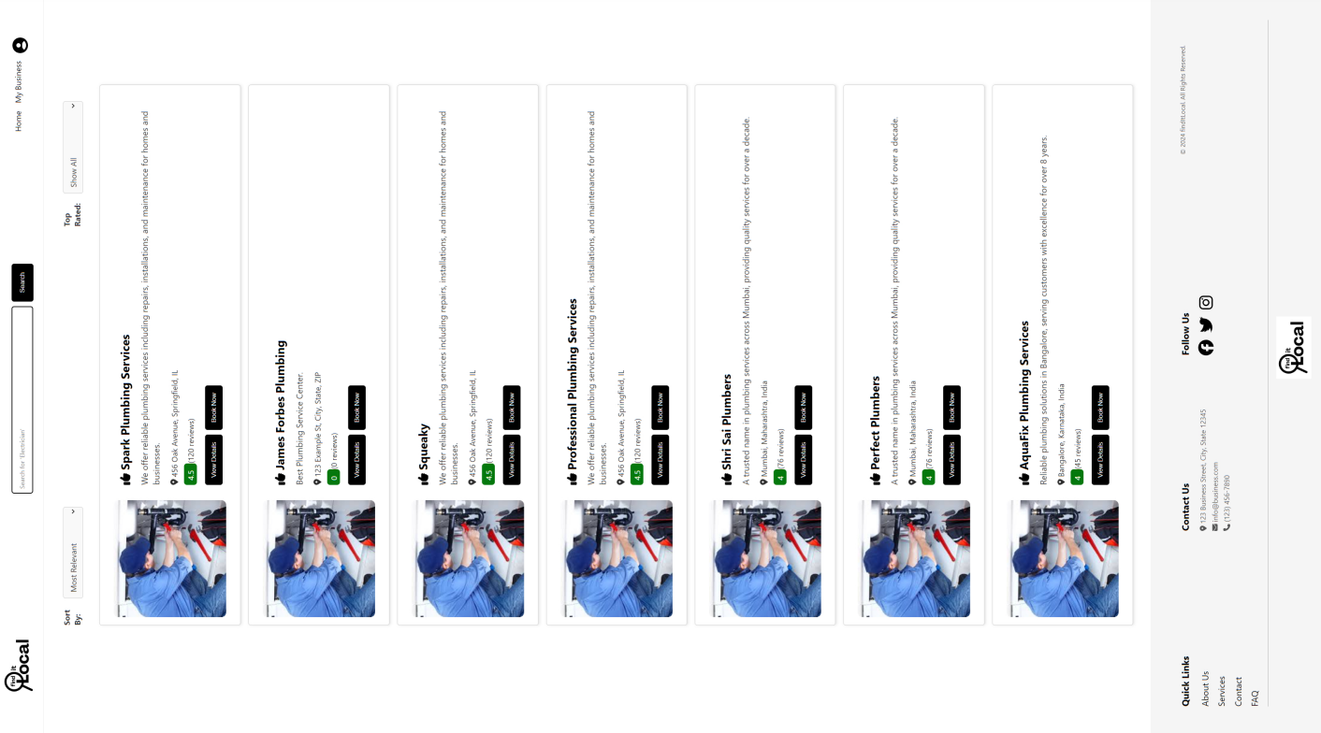
SERVICE LISTING PAGE

Slide 17
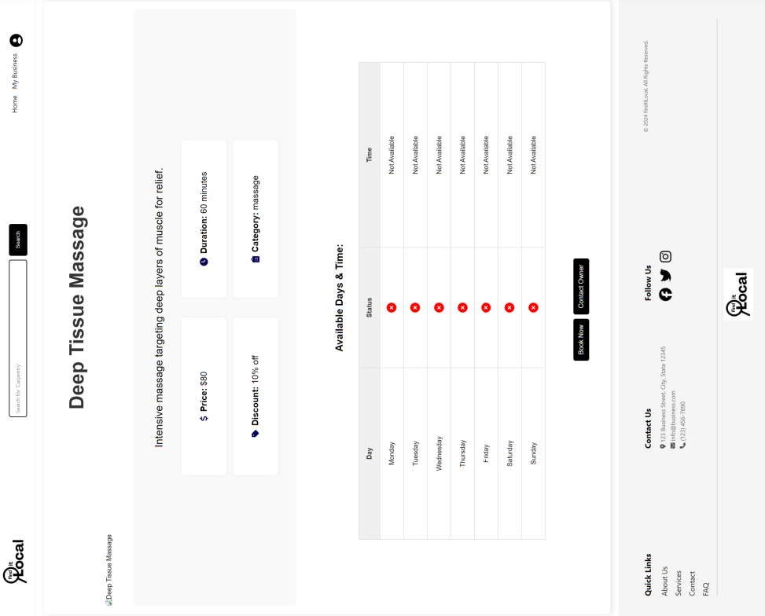
SERVICE DETAILS PAGE

Slide 18
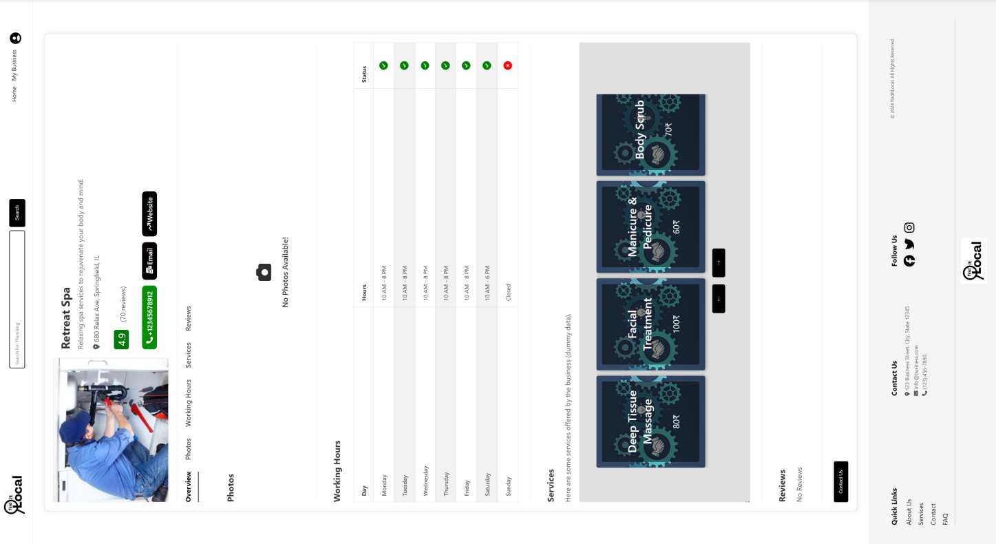
BUSINESS DETAIL PAGE

Slide 19
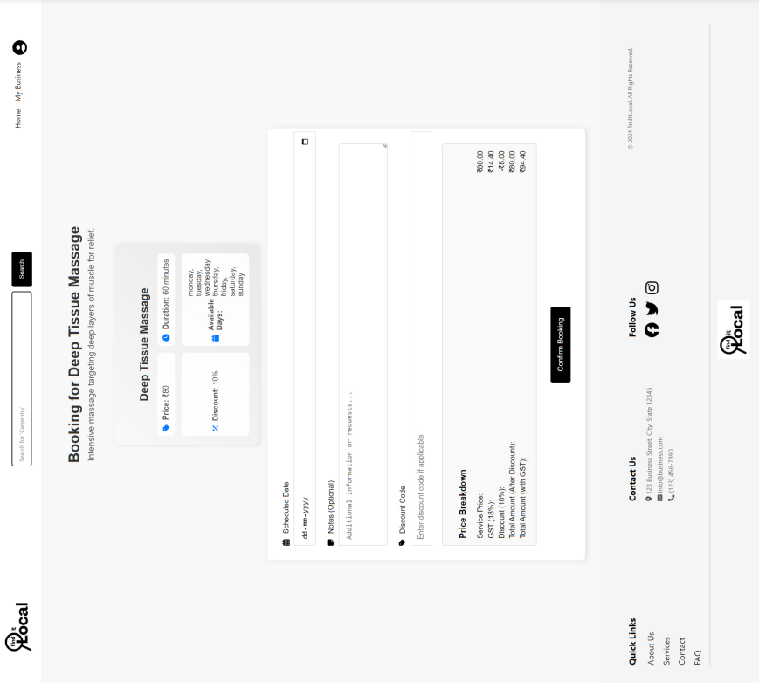
SERVICE BOOKING PAGE

Slide 20
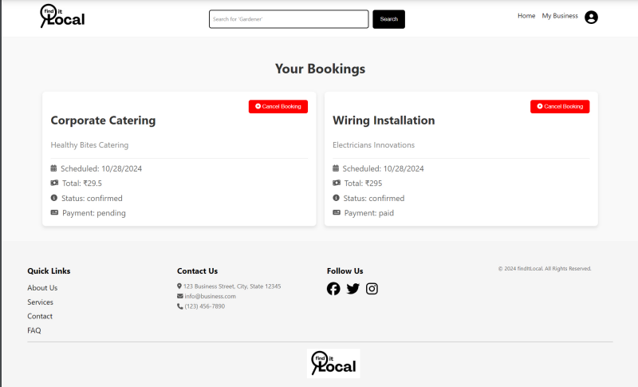
BOOKING HISTORY PAGE

Slide 21
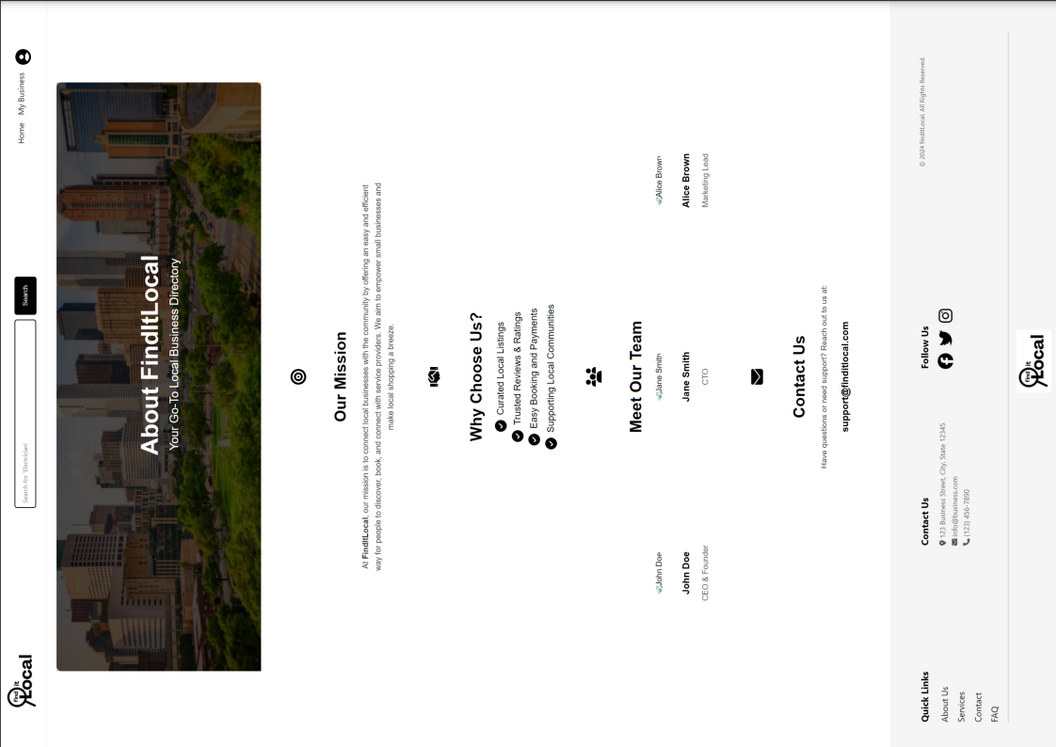
ABOUT US PAGE

Slide 22
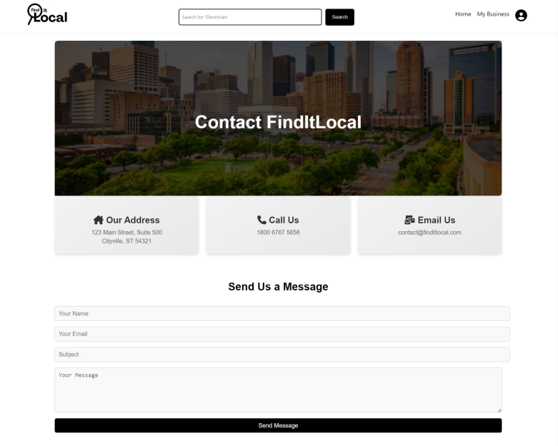
CONTACT US PAGE

Slide 23
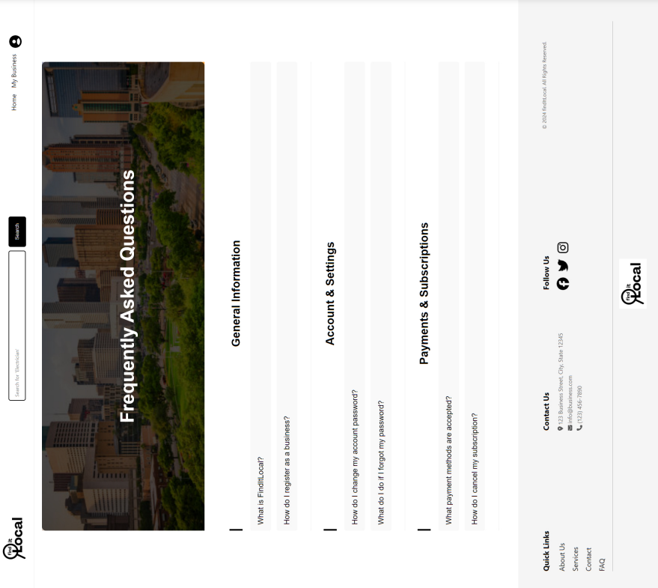
FAQ PAGE

Slide 24
CONCLUSION
In conclusion, a modern local service provider website is essential for any local service provider aiming to thrive in today’s digital landscape.
By addressing the limitations of the current system such as poor navigation, lack of mobile responsiveness, and limited customer interaction the business can enhance its online presence, improve customer satisfaction, and operations.
An optimized and secure website will serve as a powerful tool to attract and retain customers, ultimately driving growth and success.

Slide 25
REFERENCES
https://bro4u.com/city/bangalore
https://www.urbancompany.com/mumbai

